Slide 1
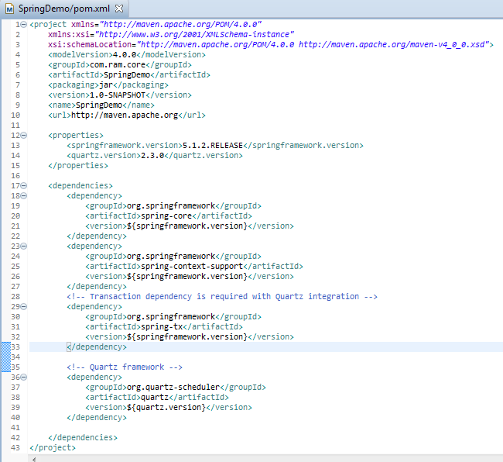
Spring 5 + Quartz Scheduler Integration Example [Using JobDetailFactoryBean]

Slide 2
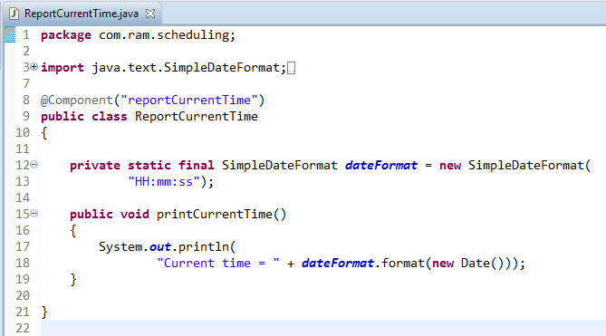
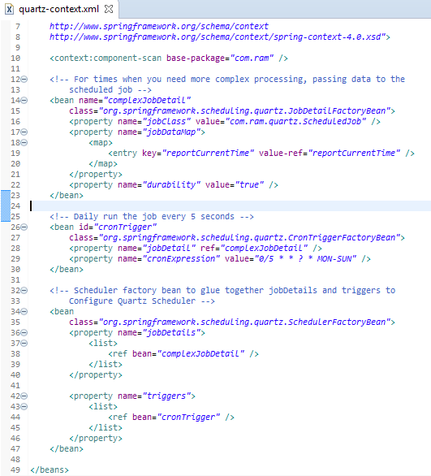
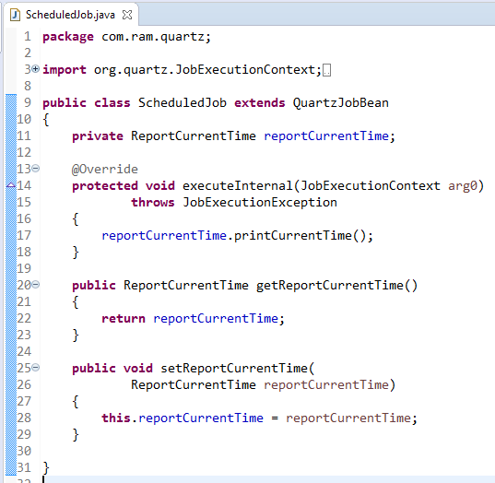
Spring 5 + Quartz Scheduler Integration Example [Using JobDetailFactoryBean]
When you need more advanced setup, need to pass data to job, being more flexible.
CronTriggerFactoryBean is more flexible and allows you to choose scheduled job at specific instance (time, day, date,..) and frequency in future.
SchedulerFactoryBean glues together jobDetails and triggers to Configure Quartz Scheduler

Slide 3
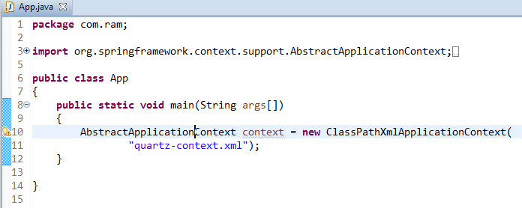
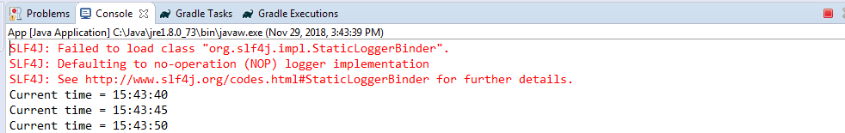
Spring 5 + Quartz Scheduler Integration Example [Using JobDetailFactoryBean]

